Slide 1
Cache Memory

Slide 2
Cache Memory
Cache is a type of memory that is used to increase the speed of data access.
Normally, the data required for any process resides in the main memory.
The data or contents of the main memory that are used frequently by CPU are stored in the cache memory so that the processor can easily access that data in a shorter time.

Slide 3
Cache Memory
Whenever the CPU needs to access memory, it first checks the cache memory.
If the data is not found in cache memory, then the CPU moves into the main memory.
Cache memory is used to reduce the average time to access data from the Main memory.
The cache is a smaller and faster memory which stores copies of the data frequently used from main memory locations.

Slide 4
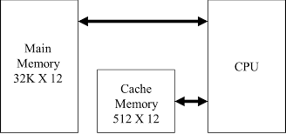
Cache Memory
Cache memory is placed between the CPU and the main memory. The block diagram for a cache memory can be represented as:

Slide 5
Cache Performance
The cache performance can be explained using the following steps −
If a process needs some data, it first searches in the cache memory.
If the data is available in the cache, this is termed as a cache hit and the data is accessed as required.
If the data is not in the cache then it is termed as a cache miss.

Slide 6
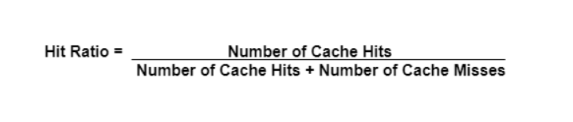
Cache Performance
Then the data is obtained from the main memory. After that the data is transferred to the cache memory under the assumption that it will be needed again.
The performance of the cache is measured using the hit ratio. It is the number of cache hits divided by the total cache accesses. The formula for this is:

Slide 7
Types of Cache Memory:
L1: It is the first level of cache memory, which is called Level 1 cache or L1 cache.
In this type of cache memory, a small amount of memory is present inside the CPU itself.
The size of this memory ranges from 2KB to 64 KB. The L1 cache further has two types of caches:
Instruction cache, which stores instructions required by the CPU, and the data cache that stores the data required by the CPU.

Slide 8
Types of Cache Memory:
L2: This cache is known as Level 2 cache or L2 cache. This level 2 cache may be inside the CPU or outside the CPU.
In case it is outside the CPU, it is connected with the CPU with a very high-speed bus.
The memory size of this cache is in the range of 256 KB to the 512 KB. In terms of speed, they are slower than the L1 cache.

Slide 9
Types of Cache Memory:
L3: It is known as Level 3 cache or L3 cache. This cache is not present in all the processors; some high-end processors may have this type of cache.
Although it is slower than L1 and L2 cache, it is faster than Random Access Memory (RAM).

Slide 10
Locality of reference
Locality of reference – Since size of cache memory is less as compared to main memory. So to check which part of main memory should be given priority and loaded in cache is decided based on locality of reference.
Types of Locality of reference
Spatial Locality of reference
Temporal Locality of reference

Slide 11
Spatial Locality of reference
Spatial locality means instruction or data near to the current memory location that is being fetched, may be needed by the processor.
If an item is accessed in Memory, then items with near by addresses will tend to be referenced next.
(Referencing Instructions in sequence.)

Slide 12
Temporal Locality of reference
Temporal locality means current data or instruction that is being fetched may be needed soon.
If an item is accessed in Memory, then same item with will be referenced again in future.
(Referencing Instructions in loop.)

Slide 13
What is Cache Mapping?
Whenever a cache hit occurs,
The word that is required is present in the memory of the cache.
Then the required word would be delivered from the cache memory to the CPU.

Slide 14
Cache Mapping
And, whenever a cache miss occurs,
The word that is required isn’t present in the memory of the cache.
The page consists of the required word that we need to map from the main memory.
We can perform such a type of mapping using various different techniques of cache mapping.

Slide 15
Cache Mapping
Cache mapping refers to a technique using which the content present in the main memory is brought into the memory of the cache.
Three distinct types of mapping are used for cache memory mapping.
Direct Mapped Cache.
Associative Mapping Technique.
Set Associative Mapping Technique.

Slide 16
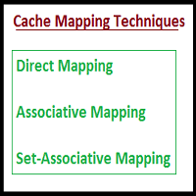

Slide 17
Direct Mapping
Direct mapping is a procedure used to assign each memory block in the main memory to a particular line in the cache.
If a line is already filled with a memory block and a new block needs to be loaded, then the old block is discarded from the cache.

Slide 18
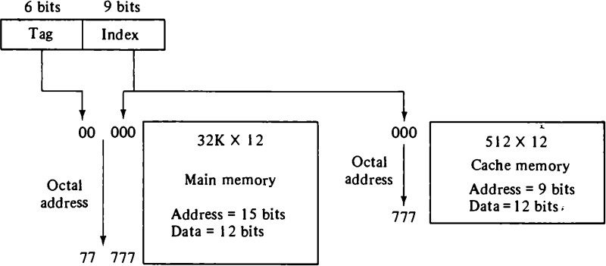
Direct Mapping
Fig. Addressing relationship between Main and Cache Memory

Slide 19
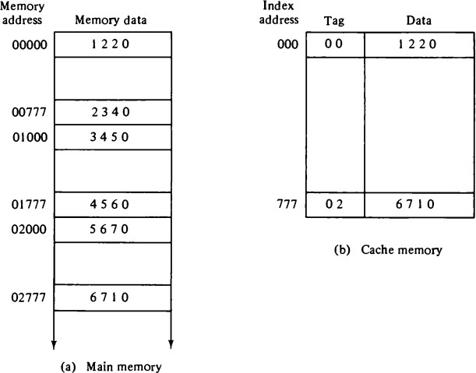
Direct Mapping
Fig. Direct Mapping cache organization

Slide 20
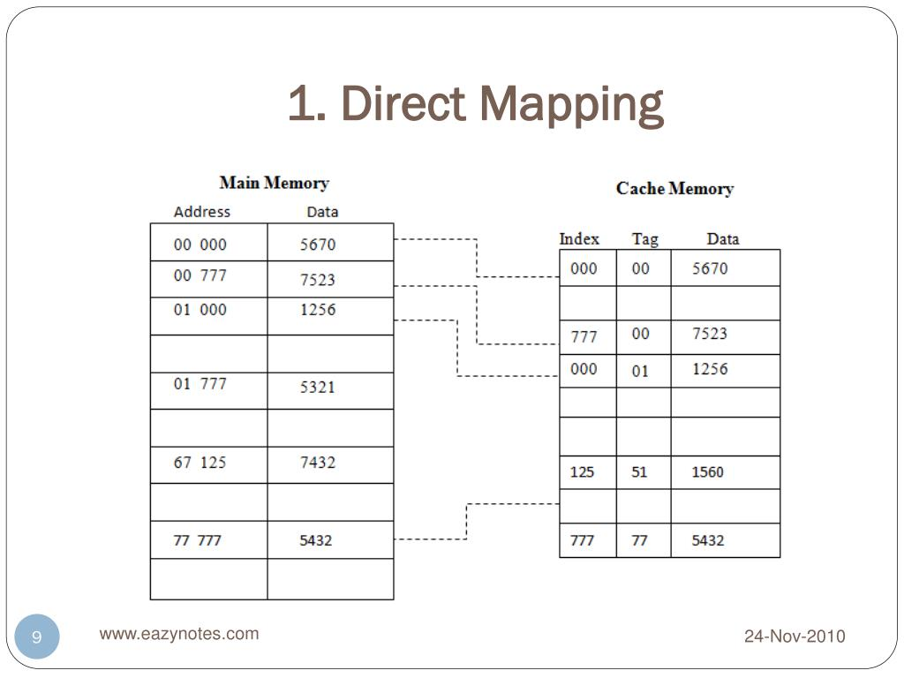

Slide 21
Direct Mapping
The CPU address of 15 bits is divided into two fields. The nine least significant bits constitute the index field and the remaining six bits form the tag field.
The main memory needs an address that includes both the tag and the index bits.
The number of bits in the index field is equal to the number of address bits required to access the cache memory.

Slide 22
Direct Mapping
The n-bit memory address is divided into two fields: k bits for the index field and n - k bits for the tag field.
The direct mapping cache organization uses the n-bit address to access the main memory and the k-bit index to access the cache.
It is easy to implement, but not Flexible.

Slide 23
Associative Mapping
In this type of mapping, the associative memory is used to store content and addresses of the memory word.
The fastest and most flexible cache organization uses an associative memory.
The associative memory stores both the address and content (data) of the memory word.

Slide 24
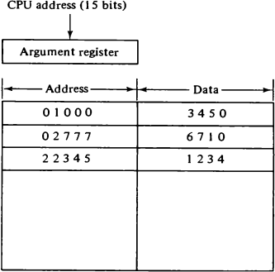
Associative Mapping:
Fig. Associative Mapping Cache

Slide 25
Associative Mapping:
This is more flexible mapping method, in which main memory block can be placed into any cache block position.
The address value of 15 bits is shown as a five-digit octal number and its corresponding 12 -bit word is shown as a four-digit octal number.
A CPU address of 15 bits is placed in the argument register and the associative memory is searched for a matching address.

Slide 26
Associative Mapping:
If the address is found, the corresponding 12-bit data is read and sent to the CPU.
If no match occurs, the main memory is accessed for the word.
In this, 12 tag bits are required to identify a memory block when it is resident in the cache.
The tag bits of an address recevied from the processor are compared to the tag bits of each block of the cache to see, if the desired block is present.

Slide 27
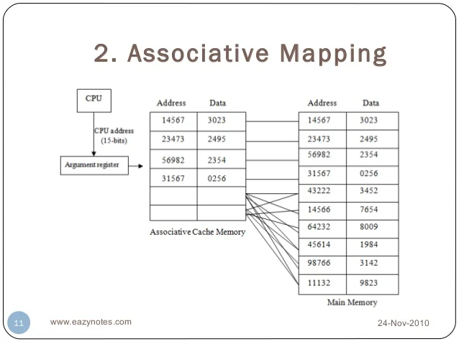
Associative Mapping:

Slide 28
Set-Associated Mapping:
It is the combination of direct and associative mapping technique.
A third type of cache organization, called set-associative mapping, is an improvement over the direct mapping organization in that each word of cache can store two or more words of memory under the same index address.
Each data word is stored together with its tag and the number of tag-data items in one word of cache is said to form a set.

Slide 29
Set-Associated Mapping:
. In general, a set-associative cache of set size k will accommodate k words of main memory in each word of cache.
When the CPU generates a memory request, the index value of the address is used to access the cache.
The tag field of the CPU address is then compared with both tags in the cache to determine if a match occurs.

Slide 30
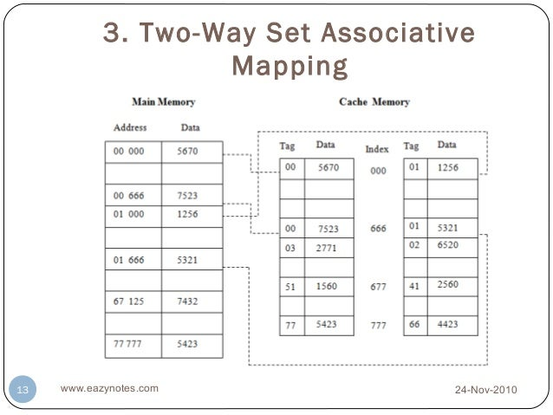
Set-Associated Mapping:

Slide 31


